Slide 1
How the World Began
Native American Creation Myths

Slide 2
The Iroquois Story
What does this creation myth tell you about the roles of women in Native American society?
Think about Sky Woman and her actions and interactions
Think about Sky Woman’s daughter and her life and death
Think about Sky Woman’s death

Slide 3
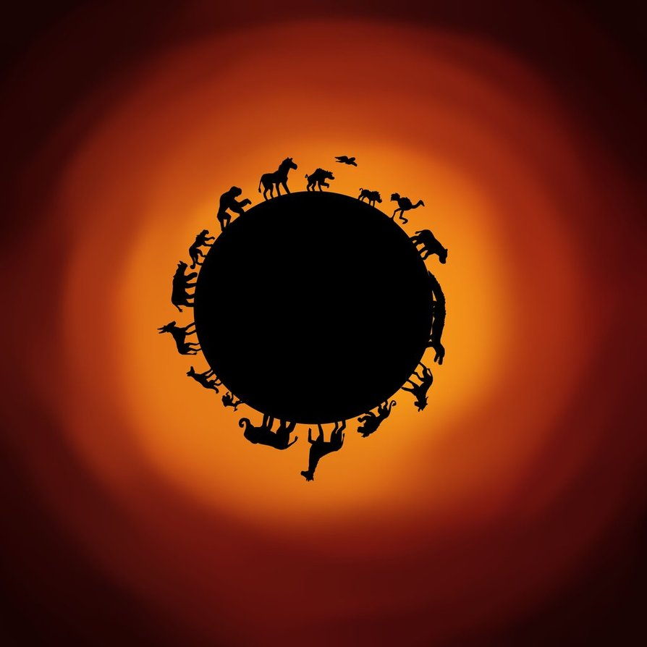
The Iroquois Story
How does this myth support the idea of interconnectedness between the creator, the earth, and the animals?
Heavenly representation? Nature? Humanity?
How do they work together? Interactions?
What makes this story cyclical? In other words, how does the story support the idea of the circle of life?

Slide 4
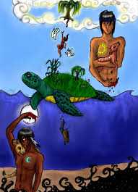
The Iroquois Story
What lesson can we learn about balance from the twin brothers?

Slide 5
The Pima Story
Why do you think it was so important to the Earth Doctor to create light in a world of darkness? Symbolically, what might this mean?

Slide 6
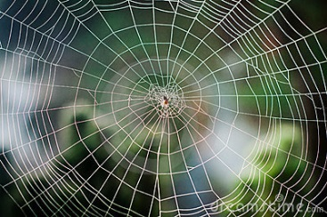
The Pima Story
How do animals help the Earth Doctor in his creation of the world?
Think: similar to Iroquois story?

Slide 7
The Pima Story
Note all of the instances in this myth in which the number four appears. What is the significance of this number?
Why is it important that the Earth Doctor does not always succeed on the first try when he is creating elements of the earth? What lesson might this teach?

